Slide 1

Windows Deployment and Management
MODULE 8

Slide 2

Chapter Overview
In this module, we'll go through the following topics:
Deploying existing Windows devices into Microsoft Endpoint Manager
What about on-premises devices?
Co-management
Tenant attach
Microsoft Surface and other Original Equipment Manufacturer (OEM) devices
Windows Update for Business
Windows 10 and Windows 11 update rings
Notes:
In this chapter, you will get a clear understanding of deploying and updating Windows 10 Enterprise with Microsoft Endpoint Manager's Intune for different cloud PC and physical PC Microsoft Endpoint Manager-managed endpoint scenarios. You'll learn about the different deployment methodologies and other features that you can use to provide Windows updates and management at the enterprise level.

Slide 3

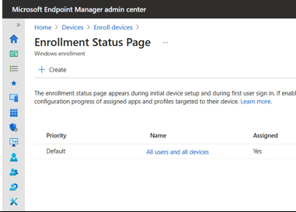
Deploying existing Windows devices into Microsoft Endpoint Manager
Physical Deployment Scenario Only.
Windows Autopilot
Notes:
In enterprise companies today, the normal approach is to leverage OS deployment either from Microsoft Endpoint Manager Configuration Manager or Microsoft Deployment Toolkit.
Microsoft Deployment Toolkit is simpler as it only requires access to a share, where the Windows 10 OS driver application is stored.
Both Configuration Manager and Deployment Toolkit often require the device to be on-premises to join the corporate Active Directory (AD) and have access to the Preboot eXecution Environment (PXE) server to even getting started with OS deployment.
Over the last few decades, enterprise companies have started to delete all the work that the OEM put into making a device run in the most optimal way with Windows 10, drivers, and the combination of the settings that are needed on a brand-new device to perform in the best way possible. This was done by leveraging a wipe and load imaging concept, and only what the company approved to be installed on the devices would be installed. Normally, this would be an older version of Windows, older versions of drivers, and Microsoft Enterprise apps.
If only it were possible to do this in a simpler way and from anywhere. With the outbreak of Covid-19 and almost everybody working from home, luckily, modern technology has allowed us to disconnect from physical locations and move to working from anywhere. This also includes provisioning a brand-new device to an end user's home address without the end user needing to go to the office location and get the new device. This is possible today with modern provisioning, called Windows Autopilot. We will cover Windows Autopilot at a high level in this chapter, and in more depth and with real-life examples in the next chapter.
Windows Autopilot is a group of different components of technology that come together into one service to configure new devices out of the box to get them ready for production usage. The cool thing about Autopilot is that you can also use it to reset, repurpose, and recover devices from scratch if you want to start over again. This is all done to release the IT department from doing all this work themselves; there's no infrastructure to manage as Autopilot runs as a cloud service within Microsoft Endpoint Manager, so it's simple and easy to get productive faster!

Slide 4
What is Windows Autopilot?
Notes:
Windows Autopilot
In this section, you will learn a bit more about Autopilot. We will spend more time on Autopilot later on in the book.
Windows Autopilot works with so-called deployment profiles that let you customize the out-of-the-box experience for your devices. This makes it easier for customers to create their own set of configuration items out of the box without any user interaction. We'll explain more about this in the next chapter.
Windows Autopilot simplifies the Windows device life cycle, from initial deployment to end of life for both IT and end users. Using cloud-based services, Windows Autopilot does the following:
Reduces the time IT spends on deploying and managing devices
Reduces the infrastructure required to onboard and maintain devices
Has the option to use break-fix and Autopilot Reset for end-users or IT admins
More about the Autopilot enrollment flow can be learned from the following diagram, based on the profiles explained earlier in this section:

Slide 5
Learning objectives
By the end of this module, you will be able to:
Configure Windows Autopilot
Create and assign a Windows Autopilot profile
Deploy and validate Windows Autopilot
Explain how the Autopilot self-deployment model deploys Windows 10 with little or no user interaction
Explain how the Autopilot pre-provisioned deployment model enables end users to provision new devices by using the preinstalled OEM image and drivers
Explain how the Autopilot user-driven deployment model enables new Windows 10 devices to be transformed from their initial factory state without requiring IT personnel to ever touch the device
Deploy BitLocker encryption for Autopiloted devices

Slide 6
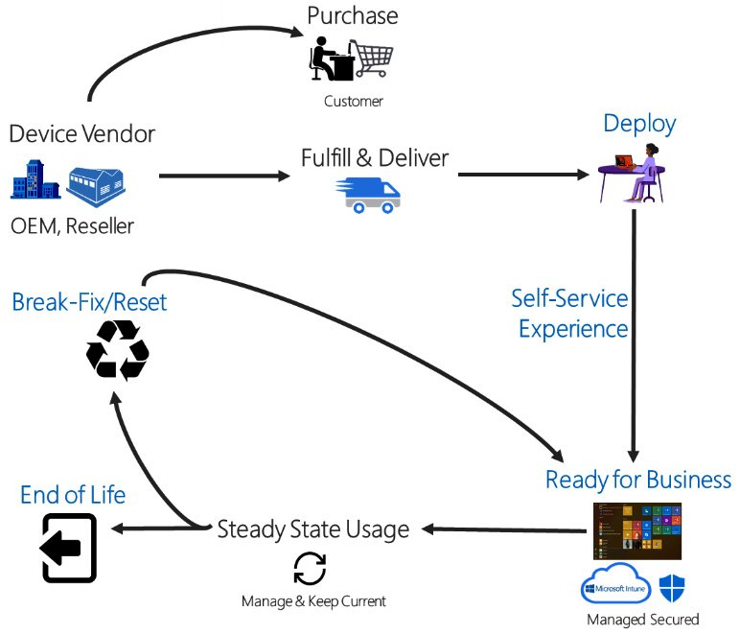
Exploring Windows Autopilot
p131
Using cloud-based services, Windows Autopilot does the following:
Reduces the time IT spends on deploying and managing devices
Reduces the infrastructure required to onboard and maintain devices
Has the option to use break-fix and Autopilot Reset for end-users or IT admins
Figure 28– Autopilot process
Notes:
Windows Autopilot works with so-called deployment profiles that let you customize the out-of-the-box experience for your devices. This makes it easier for customers to create their own set of configuration items out of the box without any user interaction. We'll explain more about this in the next chapter.
Windows Autopilot simplifies the Windows device life cycle, from initial deployment to end of life for both IT and end users. Using

Slide 7
Windows Autopilot existing infrastructures
What about existing infrastructures?
We talked about the broader unified endpoint management concept of Microsoft Endpoint Manager in the first two chapters, explaining that you could manage and maintain all your devices from one single unified dashboard console.
We do recognize that not all customers are moving directly to Microsoft Endpoint Manager in an AAD-managed manner.
Therefore, is god to know that co-managing existing on-premises Windows 10/11 devices and hybrid AAD-joined devices is supported too within Microsoft Endpoint Manager.
Notes:
What about existing infrastructures?
We talked about the broader unified endpoint management concept of Microsoft Endpoint Manager in the first two chapters, explaining that you could manage and maintain all your devices from one single unified dashboard console.
We do recognize that not all customers are moving directly to Microsoft Endpoint Manager in an AAD-managed manner. Therefore, co-managing existing on-premises Windows 10 devices and hybrid AAD-joined devices is supported too within Microsoft Endpoint Manager. This would create the same unified endpoint management experience for your hybrid configuration.

Slide 8
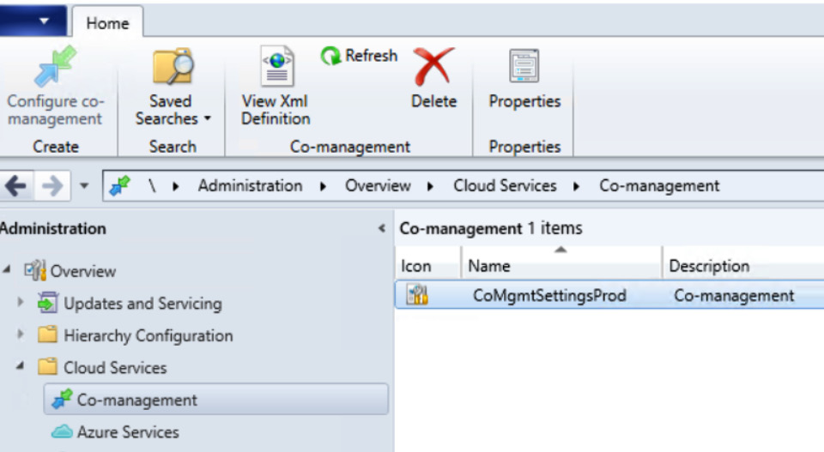
REVIEW
Co-management and tenant attach
Co-management is not a new feature
Co-management makes it possible to move workloads from Configuration Manager (formerly System Center Configuration Manager (SCCM)) to Microsoft Endpoint Manager's Intune.
Windows 10 clients managed by Configuration Manager has the management authority workloads and allows you to see and manage them from the Microsoft Endpoint Manager console.
Note: The feature mentioned above changes under the GCC High and DoD Tenants has subscription restrictions and not all features and services may be allowed for Government customers..
Notes:
Co-management and tenant attach
Co-management is not a new feature, as it has been around for a while. Co-management makes it possible to move workloads from Configuration Manager (formerly System Center Configuration Manager (SCCM)) to Microsoft Endpoint Manager's Intune. It tells the Windows 10 clients managed by Configuration Manager who the management authority is for different workloads and allows you to see and manage them from the Microsoft Endpoint Manager console. To make it simple, a co-managed device is managed by both Configuration Manager and Microsoft Endpoint Manager at the same time.
For example, with co-management, your existing Windows 10 Enterprise endpoints manager through Configuration Manager mainly listens to Configuration Manager for app deployment and security policies, while it looks at Intune for compliance policies and device configuration policies. This helps businesses combine the benefits of Configuration Manager and Microsoft Endpoint Manager without making an impactful cutover directly to Microsoft Endpoint Manager.
Important: To use co-management, you have to be using Configuration Manager version 2002 (at least).
In order to enable co-management within Configuration Manager, you must go through the Co-management Configuration Wizard screen to enable device upload. Make sure to click Sign in and log on with a global administrator account.

Slide 9
REVIEW
Types of updates managed by Windows Update for Business
feature updates
Quality updates
Driver updates
Microsoft product updates
Notes:
Feature updates: Previously referred to as upgrades, feature updates contain significant feature additions and changes along with security and quality revisions. Feature updates are released semi-annually in the fall (H1) and the spring (H2).
Quality updates: Quality updates are traditional OS updates, typically released on the second Tuesday of each month, though they can be released at any time of the month. These include driver, security, and critical updates.
Driver updates: Updates for non-Microsoft drivers that are relevant to your devices. Driver updates are on by default, but you can use Windows Update for Business policies to turn them off if you prefer.
Microsoft product updates: Windows Update for Business also treats non-Windows updates (such as updates for Microsoft Office, .NET, or Visual Studio) as quality updates. These non-Windows updates are known as Microsoft updates and you can set devices to receive such updates (or not) along with their Windows updates.

Slide 10
How do Windows updates work?
There are four phases to the Windows update process:
Scan
Download
Install
Commit
restart
Notes:
There are four phases to the Windows update process:
Scan: A device checks the Microsoft update server or your Windows Server Update Services (WSUS) endpoint at random intervals to see whether any updates have been added since the last time updates were searched, and then evaluates whether the update is appropriate by checking the guidelines (for example, group policies) that the administrator has set up. This process is invisible to the user.
Download: Once the device determines that an update is available, it begins downloading the update. The download process is not visible to the user. The download happens in multiple sequential phases with feature updates.
Install: After the update is downloaded, depending on the device's Windows Update settings, the update is installed on the system.
Commit and restart: Once installed, the device usually (but not always) must be restarted in order to complete the installation and begin using the update. Before that phase, a device runs the previous version of the software.

Slide 11
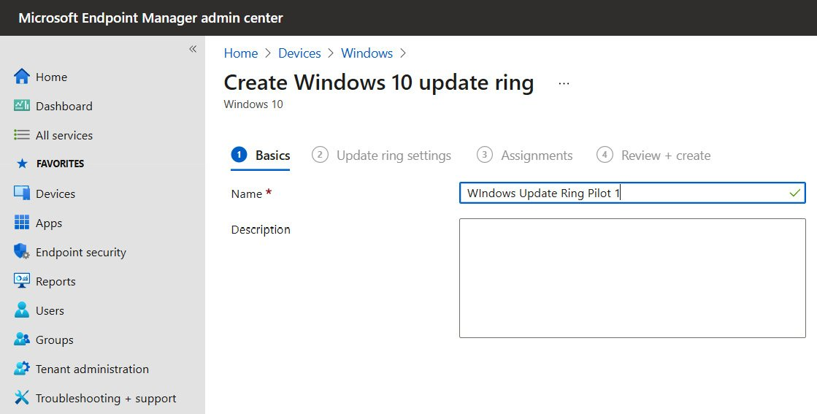
Setup and configure Windows Update for Business
Windows 10 update ring
Windows 10 feature updates
Notes:
Windows 10 update ring: This policy is a collection of settings that configures when Windows 10 updates get installed. Windows 10 update ring policies have been supported since Windows 10 version 1607, so it is not something completely new.
Windows 10 feature updates: This policy updates devices to the Windows version you specify, and then freezes the feature set version on those devices. This version freeze remains in place until you choose to update them to a later Windows version. While the feature version remains static, devices can continue to install quality and security updates that are available for their feature version. Windows 10 feature update policies are supported for devices that run Windows 10 version 1709 or later.

Slide 12

Introduction to Endpoint Manager Service Channels
Here's a breakdown of the different configuration settings for update ring:
Semi-Annual Channel
Semi-Annual Channel (targeted) for 1809 and below
Windows Insider – Fast
Windows Insider – Slow

Slide 13
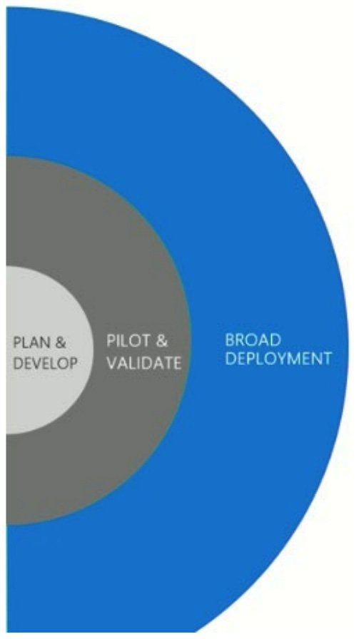
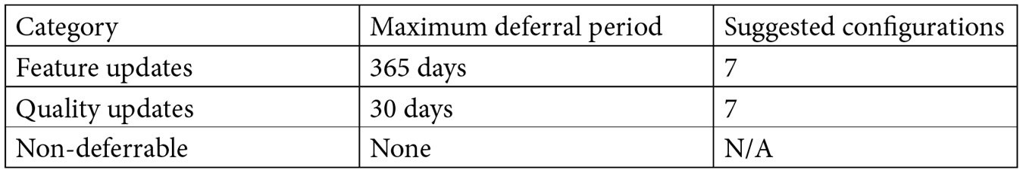
Create a ring deployment with different deferral days for the following:
Pilot group
Production ring 1
Production ring 2
Broad deployment
Notes:
Figure 38: Windows update release rings
This deferral can be used to allow time to validate deployments as and when they are pushed to devices. Deferrals work by allowing you to specify the number of days after an update is released before it is offered to a device. In this way, you can create a ring deployment with different deferral days for the following:
Pilot group
Production ring 1
Production ring 2
Broad deployment
The update release rings are visualized in the following diagram to help you understand the order better:
When moving to servicing-based Windows updates, you need controlled ways of rolling out updates to representative groups of devices. Deployment rings in Windows 10 are similar to the deployment groups most organizations have been using in the past with other deployment tools; deployment rings are simply a method to separate groups of machines into a controlled deployment timeline.
You can create as many deployment rings as you need and assign them to device groups. You assign policies for Windows 10 update rings and Windows 10 feature updates to groups of devices.
You can set a feature update deferral period of 365 days; the device will not install a feature update that has been released for less than 365 days. This is not a great option if you want to be 100% in control of the feature updates that are being installed on your corporate devices or if you want to skip feature updates and only apply them once a year to your corporate devices.

Slide 14
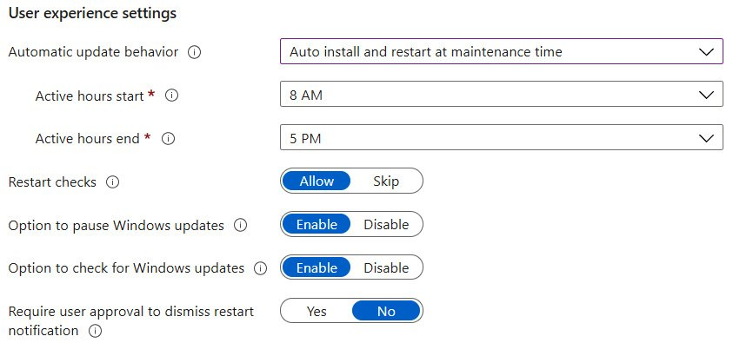
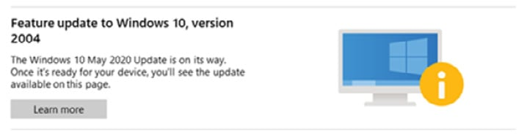
Windows Updates
Safeguard holds
Notes:
Safeguard holds
Safeguard holds prevent a Windows 10 device with a known issue from being offered a new feature update. Microsoft renews the offer once a fix is found and verified. Microsoft uses safeguard holds to ensure customers have a successful experience as their device moves to a new version of Windows 10.
The time a specific Windows 10 device or hardware model has safeguard holds varies depending on the time required to investigate and fix an issue. During this time, Microsoft works diligently to procure, develop, and validate a fix and then offer it to affected devices. Microsoft monitors quality and compatibility data to confirm that a fix is complete before releasing the safeguard hold. Once Microsoft removes the safeguard hold, Windows Update will automatically resume offering the Windows feature that was on the safeguard hold. A safeguard hold is not the same as an IT administrator leveraged pause in a Windows Update for Business deployment ring.
The aim of safeguards is to protect the device and user from a failed or poor upgrade experience.
When using Windows Update for Business and a device has a safeguard hold, the end user will see this message in the Windows Update part of the local settings app on the Windows 10 device:
Figure – Feature update
As there is a reason for safeguard holds, it is not recommended to manually attempt to upgrade Windows until the issue that is causing the safeguard hold is resolved.
When using Windows Update for Business and a device has a safeguard hold, the end user will see this message in the Windows Update part of the local settings app on the Windows 10 device:
Figure – Feature update
As there is a reason for safeguard holds, it is not recommended to manually attempt to upgrade Windows until the issue that is causing the safeguard hold is resolved.

Slide 15

Understanding Policy Management
MODULE 9

Slide 16

Chapter Overview
In this chapter, we'll cover the following topics:
Policy management
What is a Content Security Policy (CSP) policy?
Windows Push Notification Services (WNS)
Getting started with policy design...
Notes:
Chapter Overview
This chapter will learn how policy management from Microsoft Intune is different from Group Policy Object (GPO) and the different policy options to customize and secure your Windows 10/11 Enterprise desktops in your environment. This chapter will be very broad in terms of content, but it will give you the basic information to understand how policy management works between Windows and Microsoft Intune. We have divided policy management into three chapters in this book; following this first one, Chapter 10, Advanced Policy Management, deals with advanced policy management with different scenarios, and Chapter 11, Office Policy Management, is about office policy management from the office cloud policy service.
In this chapter, we'll cover the following topics:
Policy management
What is a Content Security Policy (CSP) policy?
Windows Push Notification Services (WNS)
Getting started with policy design...

Slide 17

Policy management
p188
Policy management within Microsoft Endpoint Manager – Intune makes it possible to configure the following options from within the Devices menu:
Compliance policies
Conditional access
Configuration profiles
Settings catalog
Scripts
Group policy analytics (preview)
Enrollment restrictions
Policy sets
Notes:
Policy management
Using Microsoft Endpoint Manager – Intune to manage your Windows 10/11 Enterprise desktops is all about standardizing and simplifying the management layer of your environment. As explained in the previous chapter, everything is centered around layering your configuration sets (and applications) separately for the guest OS to remove the need to create custom images that include these things from the get-go.
Policy management within Microsoft Endpoint Manager – Intune makes it possible to configure the following options from within the Devices menu:
Compliance policies
Conditional access
Configuration profiles
Settings catalog
Scripts
Group policy analytics (preview)
Enrollment restrictions
Policy sets
Group policy management has been around for over 20 years and has been a way to configure the behavior of a group of users or computers in a domain. This is still possible with an on-premises domain today, but if you want to start modernizing your policy and settings management, you should start looking at Microsoft Intune and the feature set it provides for policy management. There are some disadvantages associated with using GPO, one of these being that it requires a line of sight to a domain controller. Another is that GPO is fire-and-forget, but what do we mean by this? A GPO is assigned to a specific group of users and devices, and they are applied when a device is connecting to a domain controller on a regular basis. There is no reporting back to the domain controller if the device received and applied the policy correctly, if no domain controller can be contacted, or if no new or changed policies are applied.

Slide 18

Covid19 Policy management
Challenges:
Misconfiguration
Windows device can contact a domain controller far away on the internal network with very slow connectivity
Many of these issues can be avoided with a pure cloud-joined and managed device.
COVID-19
companies were forced to have their employees work from home
companies were not ready
This fact drove a new approach with MDM management of devices
Microsoft Intune emerged as the perfect match for this new way of working
Notes:
Sometimes, due to misconfiguration, a Windows device can contact a domain controller far away on the internal network with very slow connectivity, which can result in very long boot and sign-in times. Many of these issues can be avoided with a pure cloud-joined and managed device.
With COVID-19 hitting the world at the beginning of 2020, many companies were forced to have their employees work from home, something that many companies were not ready for. This also drove a new approach with MDM management of devices from the cloud. Microsoft Intune is a perfect match for this new way of working, as it just requires internet connectivity following the initial onboarding into Microsoft Intune.

Slide 19

Module Focus
Focus on pure cloud management of Azure Active Directory Windows 1011 devices:
Moving away from:
Windows devices on-premises in the office,
in production, or
with end users working at home with VPN.
Moving forward to:
best option with new devices is pure Azure Active Directory joined and onboarded with Windows Autopilot
Notes:
In this chapter, we will focus on pure cloud management of Azure Active Directory Windows 10 devices, but the same will also apply to hybrid domain-joined devices that are managed from Microsoft Intune, also in a co-managed state. One important thing to note here is that GPO and MDM settings management is on the identity layer, either users or devices, whereas co-management between Microsoft Intune and System Center Configuration Manager (SCCM) is on the management plane.
First, we need to look back at traditional Windows management, where all Windows devices were on-premises in the office, in production, or with end users working at home with VPN. Modern policy management is still an option on those devices if they are hybrid-joined to Azure Active Directory. The best option moving forward with new devices is pure Azure Active Directory joined and onboarded with Windows Autopilot. What we are covering in this chapter covers both scenarios. This book is dedicated to cloud management, and certain scenarios do not apply to a hybrid-joined device, so you need to make some decisions to go to Azure AD-joined devices to get the best end user experience. Start small, start with a Proof of Concept (POC), and showcase the benefits of modern policy management. A best practice approach is to block on-premises devices in your POC from getting GPOs from the local Active Directory; otherwise, you can end up in a situation where you are not 100% sure where the settings are being applied from.

Slide 20
Looking back at traditional Windows management
Configuration Service Provider (CSP)
Open Mobile Alliance Device Management (OMA DM).
Notes:
First, we need to look back at traditional Windows management, where all Windows devices were on-premises in the office, in production, or with end users working at home with VPN. Modern policy management is still an option on those devices if they are hybrid-joined to Azure Active Directory. The best option moving forward with new devices is pure Azure Active Directory joined and onboarded with Windows Autopilot. What we are covering in this chapter covers both scenarios. This book is dedicated to cloud management, and certain scenarios do not apply to a hybrid-joined device, so you need to make some decisions to go to Azure AD-joined devices to get the best end user experience. Start small, start with a Proof of Concept (POC), and showcase the benefits of modern policy management. A best practice approach is to block on-premises devices in your POC from getting GPOs from the local Active Directory; otherwise, you can end up in a situation where you are not 100% sure where the settings are being applied from.
A Configuration Service Provider (CSP) is an interface for reading, setting, modifying, or deleting configuration settings on the device. These settings map to registry keys or files. Some CSPs support WAP format, some support SyncML, and some support both. SyncML is only used over the air for Open Mobile Alliance Device Management (OMA DM). On the other hand, WAP can be used over the air for OMA client provisioning, or it can be included in the phone image as a .provxml file that is installed during boot.

Slide 21
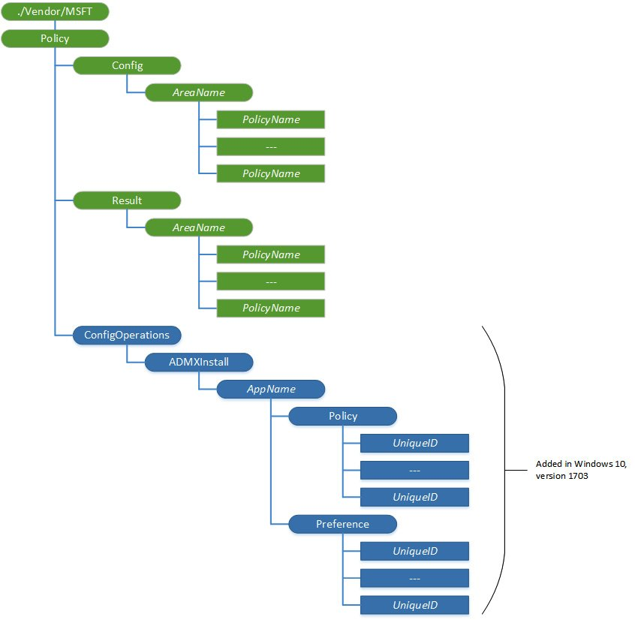
What is a CSP policy?
Disparity
configured at the device level
other policies can be configured at the user level
Device-level policies
Effect is independent of the user logging into the device
user-level policies
Effect dependent on the user logging into the device
Notes:
What is a CSP policy?
Some policies can only be configured at the device level, whereas other policies can be configured at the user level. This means that device-level policies will have an effect independent of the user logging into the device, whereas user-level policies will have an effect depending on the user logging into the device.
User scope is where the policy only applies to the user who logs into the device, and the policy can vary depending on who is logging on to the device. The following is an example of what the CSP tree looks like when configuring a user policy:
./User/Vendor/MSFT/Policy/Config/AreaName/PolicyName to configure the policy
./User/Vendor/MSFT/Policy/Result/AreaName/PolicyName to get the result
Device scope is where the policy only applies to the device itself, regardless of the user who logs into the device. The following is an example of what the CSP tree looks like when configuring a device policy:
./Device/Vendor/MSFT/Policy/Config/AreaName/PolicyName to configure the policy
The biggest difference between a GPO and a CSP policy is that a CSP policy has a result channel as well, so every setting that is being configured in the device will report back to the MDM system – in this case, Microsoft Intune.
If we take a closer look at the policy structure, it looks like the Windows registry is arranged in a tree structure:

Slide 22
User policy
./User/Vendor/MSFT/Policy/Config/AreaName/PolicyName to configure the policy
./User/Vendor/MSFT/Policy/Result/AreaName/PolicyName to get the result

Slide 23
Device policy
./Device/Vendor/MSFT/Policy/Config/AreaName/PolicyName to configure the policy

Slide 24
ADMX-backed policies
The OMA-URI string needs to go into the CSP policy URI:
./Vendor/MSFT/Policy/ConfigOperations/ADMXInstall/Applicationname/Policy/ADMXFileName.
./Vendor/MSFT/Policy/Config/ remains the same for all machine policies that you are deploying to the device.
Notes:
By using ADMXInstall, you can add ADMX-backed policies for those Win32 or Desktop Bridge apps that have been added between OS releases. ADMX-backed policies are ingested in your device by using the CSP policy URI: ./Vendor/MSFT/Policy/ConfigOperations/ADMXInstall.
The OMA-URI string needs to go into the CSP policy URI:
./Vendor/MSFT/Policy/ConfigOperations/ADMXInstall/Applicationname/Policy/ADMXFileName.
./Vendor/MSFT/Policy/Config/ remains the same for all machine policies that you are deploying to the device.
Applicationname and ADMXFileName are user-defined. In this case, Applicationname is App1, and you can use the same name as ADMXFileName. Just remember that ADMXFileName needs to be unique, which means you cannot deploy two ADMX files with the same name on a device.

Slide 25
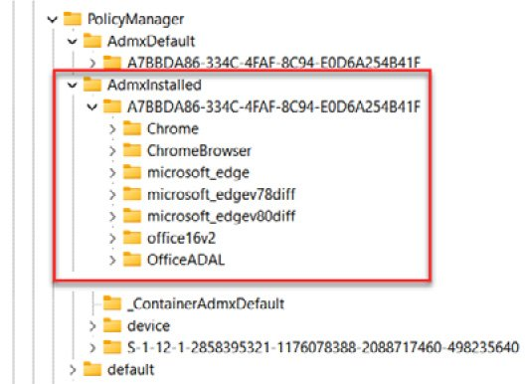
Content of the ADMX file
HKLM\SOFTWARE\MICROSOFT\PolicyManager\AdmxInstalled.
HKLM\Software\Microsoft\PolicyManager\AdmxDefault
Notes:
Then, if you take a closer look at the registry, the first place where they are written is HKLM\SOFTWARE\MICROSOFT\PolicyManager\AdmxInstalled.
The policy is always declared under a GUID and with the name you gave the policy in Microsoft Intune when you created the policy. Then, you will be able to see the naming of the policy category that you are using when creating a policy setting:
HKLM\Software\Microsoft\PolicyManager\AdmxDefault
If the policy is a device policy, you will be able to see the direct results that apply to the devices in the following location: HKEY_LOCAL_MACHINE\SOFTWARE\Microsoft\PolicyManager\current\device.
In the end, all a policy does on a Windows device is set some registry keys, and it is the same with MDM policies. All the policy settings go here: HKEY_LOCAL_MACHINE\SOFTWARE\Policies\.
MDM policies are applied when a device syncs, either from Microsoft Intune or as part of the 8-hour schedule when a Windows device is running with MDM sync on.

Slide 26
Getting started with policy design
Creating policies:
Configure the security baseline.
Configure policy from the Endpoint Security blade.
Configure policy from the Settings catalog.
Configure the administrative template.
Configure the device configuration.
Leverage a custom policy as the last resort.
Notes:
Getting started with policy design
When designing your strategy on policy management with Microsoft Intune, it is important to take the right approach. There are several policy types in Microsoft Intune. In the following list, you can see the different policy types and the order in which you should start creating policies:
Configure the security baseline.
Configure policy from the Endpoint Security blade.
Configure policy from the Settings catalog.
Configure the administrative template.
Configure the device configuration.
Leverage a custom policy as the last resort.
Just remember that there are no rights and wrongs, but if you're undertaking a migration from AD GPO to MDM settings management, it might be a good time to start afresh and see what you need to configure instead of taking your history of GPO setting in your on-premises environment with you. Sometimes, organizations do not even know why they implemented a specific policy setting back when they did. Perhaps the person responsible for implementing this policy setting is no longer even with the company and did not leave any documentation on why this setting was configured the way it was in the first place.
As there is no conflict handling incorporated in the MDM stack, you may inadvertently create a conflict between two settings coming from two different policies to the same user or device.
This can be from the same policy type or different policy types, so it is important to notice and monitor any conflicting policies.
In the Microsoft Endpoint Manager admin center, under each device, go to Monitor | Device configuration:

Slide 27

Windows Push Notification Services (WNS)
Microsoft Intune makes an HTTP POST to the channel URI. This request is made over SSL and contains the necessary headers and the notification payload.
WNS responds to indicate that the notification has been received and will be delivered at the next available opportunity
Notes:
Windows Push Notification Services (WNS)
WNS enables Microsoft Intune to send toast, tile, badge, and raw updates from Microsoft Intune to MDM-enrolled devices. This provides a mechanism to deliver new updates to your users in a power-efficient and dependable way:
Microsoft Intune makes an HTTP POST to the channel URI. This request is made over SSL and contains the necessary headers and the notification payload.
WNS responds to indicate that the notification has been received and will be delivered at the next available opportunity.
WNS does not provide end-to-end confirmation that your notification has been received by the device or application. Microsoft Intune provides this option by showing the status in the Device actions status view on the Overview blade for a specific device:
There is also an option for an end user to do this from the client side. On the client side, you can do a sync from Company portal...

Slide 28
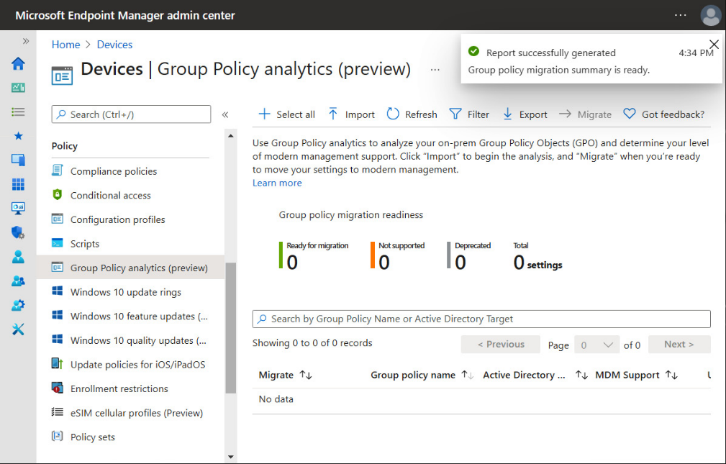
Policy management within Microsoft Endpoint Manager
You can use policy sets to do the following:
Group objects that need to be assigned together.
Assign your organization's minimum configuration requirements on all managed devices.
Assign commonly used or relevant apps to all users.
Notes:
Policy management within Microsoft Endpoint Manager
Policy sets allow you to create a bundle of references to already existing management entities that need to be identified, targeted, and monitored as a single conceptual unit. A policy set is an assignable collection of apps, policies, and other management objects you've created. Creating a policy set enables you to select many different objects at once and assign them from a single place. As your organization changes, you can revisit a policy set to add or remove its objects and assignments. In a single package, you can use a policy set to associate and assign existing objects, such as apps, policies, and VPNs.
You can use policy sets to do the following:
Group objects that need to be assigned together.
Assign your organization's minimum configuration requirements on all managed devices.
Assign commonly used or relevant apps to all users.
You can include the following management objects in a policy set:
App configuration policies
App protection policies
Device configuration profiles
Device compliance policies
Device type restrictions
Windows Autopilot deployment profiles
Enrollment status page
Migrating policies from AD – Group Policy management (preview)
It's possible to migrate your existing Active Directory-based group policies into Microsoft Endpoint Manager – Intune. This can be done with the Group Policy analytics feature.
Many businesses that are looking at Microsoft Endpoint management need a good path to the new modern workplace. The translation of existing policy settings to Endpoint Manager could be tricky. This service will make life much easier for IT admins. Let me explain in more detail what it does and how you can use it yourself; it can be found on the Devices blade:

Slide 29
Policy management within Microsoft Endpoint Manager
You can include the following management objects in a policy set:
App configuration policies
App protection policies
Device configuration profiles
Device compliance policies
Device type restrictions
Windows Autopilot deployment profiles
Enrollment status page

Slide 30
Migrating policies from AD – Group Policy management
Notes:
Migrating policies from AD – Group Policy management (preview)
It's possible to migrate your existing Active Directory-based group policies into Microsoft Endpoint Manager – Intune. This can be done with the Group Policy analytics feature.
Many businesses that are looking at Microsoft Endpoint management need a good path to the new modern workplace. The translation of existing policy settings to Endpoint Manager could be tricky. This service will make life much easier for IT admins. Let me explain in more detail what it does and how you can use it yourself; it can be found on the Devices blade:

Slide 31

Mastering Policy Management
MODULE 10

Slide 32
Module Overview
In this module, we'll be covering the following topics:
Configuring a policy from the Endpoint Manager Security blade
Configuring your Endpoint security profile
Windows 10 unhealthy endpoints
Configuring a policy from the Settings catalog
Configuring administrative templates
OneDrive Known Folder Move configuration
OneDrive – block syncing specific file extensions
Configure device configuration (template)
Leveraging a custom policy as the last resort
Pushing PowerShell scripts – scripted actions to endpoints
Compliance policies
Organizational compliance report

Slide 33
Advanced Policy management
Configuring a policy from the Endpoint Manager Security blade
Windows 10 Security Baseline
Microsoft Defender for Endpoint Baseline
Windows 365 Security Baseline (Preview)
Microsoft Edge Baseline
Notes:
We will cover different scenarios – some partial scenarios and some end-to-end scenarios. The most important part of this chapter will give you an insight into all the different policy options that exist in Microsoft Intune, and when and how you can leverage the different policy types in the best way to accomplish the task you need for your enterprise.
Using Microsoft Intune, a part of Microsoft Endpoint Manager, to manage your Windows 10 or 11 Enterprise desktops is all about standardizing and simplifying the management layer of your environment. In Chapter 9, Understanding Policy Management, we covered the basics of how MDM policies work on the client side. We also learned how to get started with MDM policy management either from scratch or with Group Policy analytics.
In this chapter, we will look at different ways to configure settings within Microsoft Intune. We will start with security baselines as those are best practices for securing your desktops.
Configuring a policy from the Endpoint Manager Security blade
You should start with a security baseline if your organization is ready for it. Let's say that your organization is already leveraging a Microsoft security baseline such as Center for Internet Security (CIS) Benchmarks. With GPOs today, you already know the impact that a security baseline can have on your Windows production environment. There are multiple different baselines in Microsoft Intune:
Windows 10 Security Baseline
Use the Windows 10 security baseline to help you secure and protect your users and devices. This baseline consists of recommendations for settings that impact security and is created by the Windows Security team. If you are already using some kind of security baseline in your Group Policy Object (GPO) today, it is highly recommended to adopt the Intune Windows 10 security baseline as well.
Microsoft Defender for Endpoint Baseline
The Microsoft Defender for Endpoint baseline represents the default recommended configuration for Defender for Endpoint and might not match baseline defaults for other security baselines. This means that if you are leveraging this baseline in conjunction with the Windows 10 Security baseline, you can create conflicts between the different policy settings.
Windows 365 Security Baseline (Preview)
The Windows 365 Security baseline provides a set of policy templates built on security best practices and experience from real-world implementations. You can use security baselines to get security recommendations that can help lower risks. The Windows 365 baseline is one baseline for Cloud PC with security settings for Windows, Microsoft Edge, and Microsoft Defender for Endpoints. This also means that you should not assign other security baselines to the same group of devices as it can end up in a policy conflict.
Microsoft Edge Baseline
The Microsoft Edge baseline sets the recommended configuration for the Microsoft Edge browser. The Microsoft Edge security baseline has a very small footprint and only sets security-related settings, so it is easy to test out in your organization. If you are allowing your users to use different browsers on company-owned Windows 10 devices, you should also create a security baseline on those third-party browsers; otherwise, there is a risk that your end users will always use the least secure browser.
Be aware that when a baseline changes its version, the old one will be read-only. You can continue to use those profiles but you won't be able to edit them. You should change the baseline version to take advantage of the newest recommendations every time a new version is released.
The Microsoft Edge baseline defaults represent the recommended configuration for Microsoft Edge browsers, so they might not match the baseline defaults of other security baselines.

Slide 34
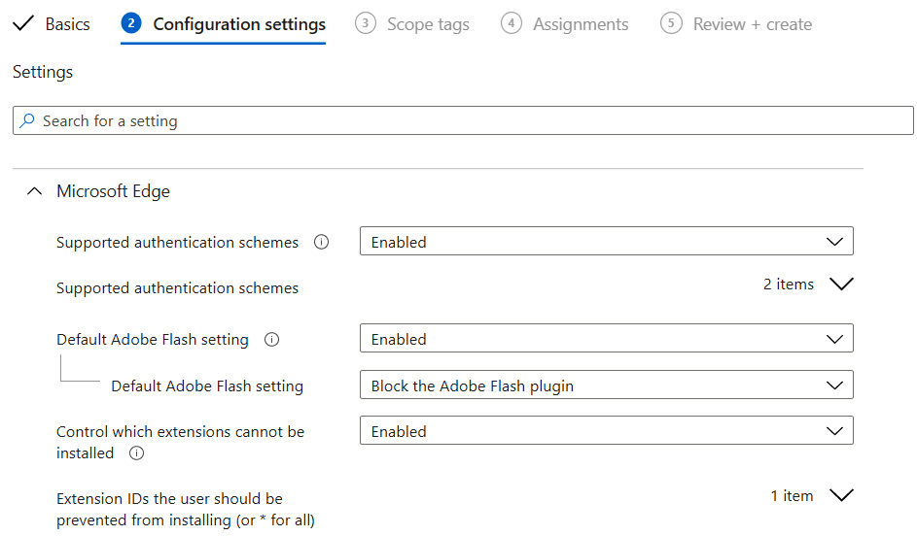
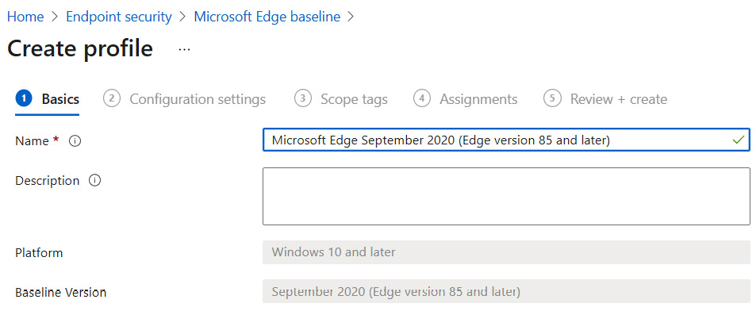
Configuring your Endpoint security profile
Microsoft Edge baseline policy

Slide 35
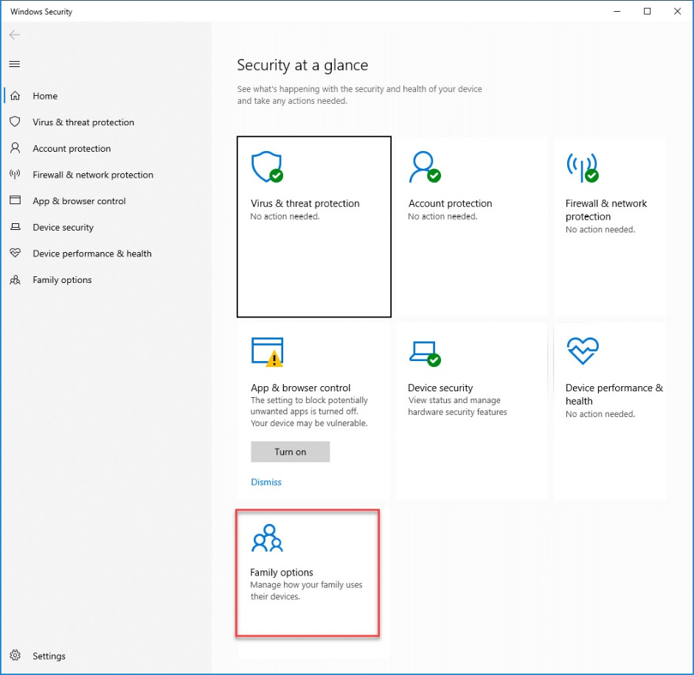
Windows Security experience
Notes:
Windows Security experience
The Windows Security app is used by several Windows security features to provide notifications about the health and security of a machine. Security app notifications include firewalls, antivirus products, and Windows Defender SmartScreen.
The Windows Security experience profile can be used to turn off areas in the Windows Security app, such as family options if you don't want to show family options on your Intune-managed devices:

Slide 36
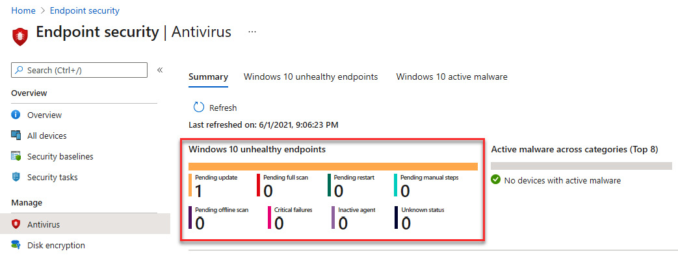
Windows Security experience
Microsoft Defender Antivirus
Microsoft Defender Antivirus exclusions
Antivirus reporting in Endpoint security
Notes:
Microsoft Defender Antivirus
Microsoft Defender Antivirus is a next-generation antivirus solution that brings together technologies such as machine learning and cloud infrastructure to protect devices in your enterprise organization.
Microsoft Defender Antivirus
Microsoft Defender Antivirus is a next-generation antivirus solution that brings together technologies such as machine learning and cloud infrastructure to protect devices in your enterprise organization.
Microsoft Defender Antivirus exclusions
These configuration service providers (CSPs) for Microsoft Defender Antivirus exclusions are also managed by the Microsoft Defender Antivirus policy, which includes identical settings for exclusions. Settings from both policy types (antivirus and antivirus exclusions) are subject to policy merging. This means that you can create as many policies as you like and assign them to the same user or device without causing a conflict.
This concludes this section on Windows Defender policies. Next, we'll learn how to monitor Windows Defender in Microsoft Intune.
Antivirus reporting in Endpoint security
In the Endpoint security blade, you will also find antivirus reports displaying status details about your Endpoint security antivirus policies and devices:

Slide 37
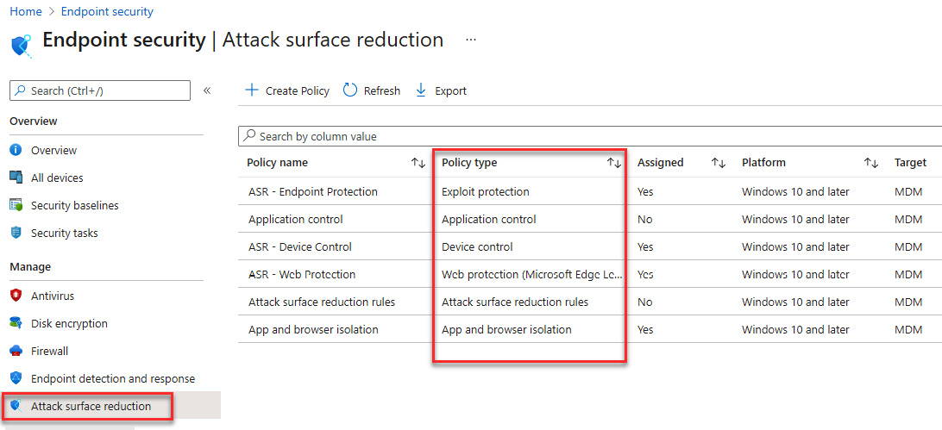
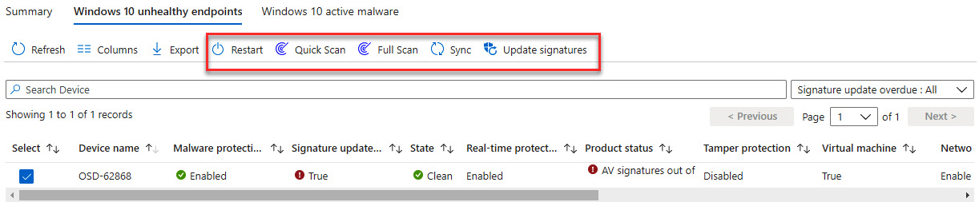
Windows 10 unhealthy endpoints

Slide 38
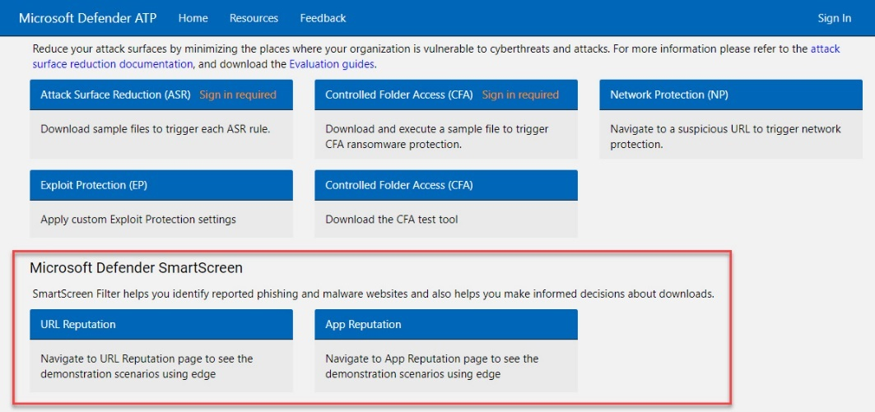
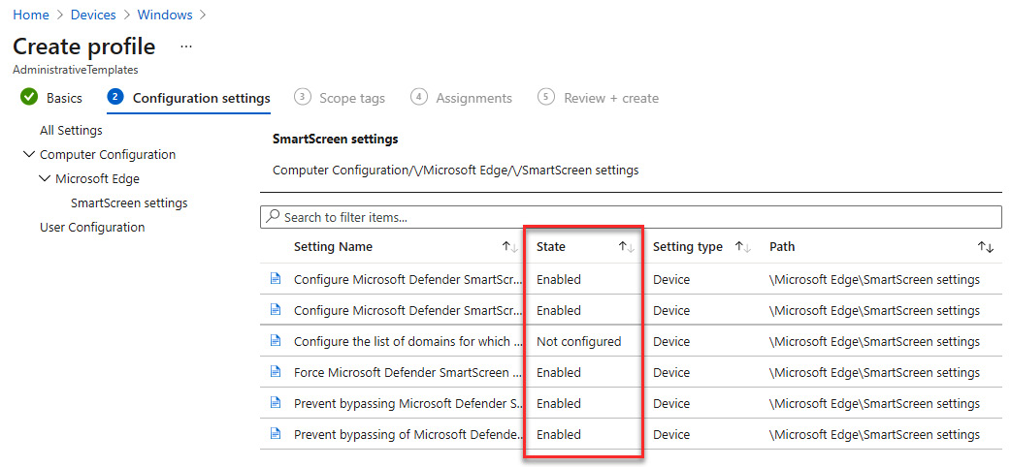
Configuring administrative templates
Computer Configuration
Notes:
Configuring administrative templates
Administrative templates include thousands of settings that control features in Microsoft Edge version 77 and later, Internet Explorer, Microsoft Office, Remote Desktop, OneDrive, passwords, PINs, and more. These settings allow IT pro administrators to manage group policies using Microsoft Intune in the cloud.
The Windows settings are GPO settings that you already know about from Active Directory (AD). These settings, which are built into Windows, are ADMX-backed settings that use XML. The Office and Microsoft Edge settings are ADMX-ingested and use the ADMX settings in Office administrative template files and Microsoft Edge administrative template files.
Administrative Templates are built into Intune and do not require a custom policy with OMA-URI. This is still necessary for third-party ADMX policies, and this will be covered later in this chapter. As part of your Microsoft Intune solution, use these template settings as a one-stop-shop to manage your Windows 10 devices.
Not all ADMX policies are whitelisted in all Windows 10 versions, so it is a good idea to keep your version of Windows 10 as current as possible in your organization. To verify what ADMX policies are supported on the Windows 10 build you are running, check the Windows policy CSP documentation: https://docs.microsoft.com/en-us/windows/client-management/mdm/policy-configuration-service-provider#policies-supported-by-group-policy-and-admx-backed-policies
Computer Configuration can be assigned to a user or device groups in Microsoft Intune. Consider leveraging device groups for your device policy.
Once you have deployed the policy to your devices, you can test the Microsoft SmartScreen functionality via Microsoft Defender Testground, at https://demo.wd.microsoft.com/:

Slide 39
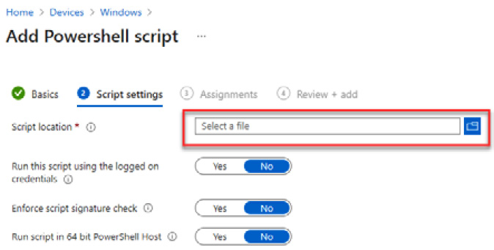
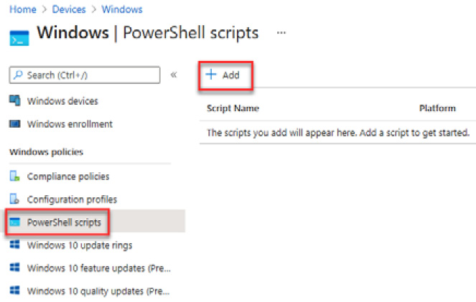
Pushing PowerShell scripts – scripted actions to endpoints
PowerShell Code Example:
$Storage = Invoke-Command {DISM /Online /Get-ReservedStorageState}
$Output = $Storage | Select-String "Reserved storage is disabled."
Write-Host $Output
If ($Output -like "Reserved storage is disabled."){
Invoke-Command {DISM /Online /Set-ReservedStorageState /State:Enabled}
} Copy
Enable ADAL for OneDrive:
$registryPath = "HKCU:\SOFTWARE\Microsoft\OneDrive"
$Name = "EnableADAL"
$value = "1"
IF(!(Test-Path $registryPath))
{
New-Item -Path $registryPath -Force | Out-Null
New-ItemProperty -Path $registryPath -Name $name -Value $value `
-PropertyType DWORD -Force | Out-Null}
ELSE {
New-ItemProperty -Path $registryPath -Name $name -Value $value `
-PropertyType DWORD -Force | Out-Null}

Slide 40
Compliance policies
Options you can configure in the built-in policy:
Mark devices with no compliance policy assigned as Default value is Compliant. This means that this security feature is disabled by default. It is recommended that you change this setting to Not Compliant so that all devices without a compliance policy will automatically be marked as non-compliant.
Enhanced jailbreak detection: Default value Disabled (applies only to iOS/iPadOS).
Compliance status validity period (days): The default value is 30 days.
Specify a period in which devices must successfully report on all their received compliance policies. If a device fails to report its compliance status for a policy before the validity period expires, the device is treated as non-compliant. You can configure a period so that it ranges from 1 to 120 days.
Notes:
Compliance policies
Microsoft Endpoint Manager can set a compliance state on a device. There are two possible outcomes for a device: compliant or noncompliant.
In Microsoft Intune, you can define the rules and settings that users and devices must meet to be compliant. If Conditional Access has been configured, then users and devices that are noncompliant can be blocked from accessing resources that contain corporate data.
Important
Conditional Access requires an Azure AD Premium license.
Include actions that apply to noncompliant devices. Actions for noncompliance can alert users to the conditions of noncompliance and safeguard data on noncompliant devices.
There are two types of compliance policies in Microsoft Intune:
Compliance policy settings: Tenant-wide settings that act like a built-in compliance policy that every device receives. The compliance policy settings set a baseline for how the compliance policy will work in your Microsoft Intune environment.
These settings configure the way the compliance service treats devices. Each device evaluates these as a Built-in Device Compliance Policy, which is reflected in device monitoring.
The following are the options you can configure in the built-in policy:
Mark devices with no compliance policy assigned as Default value is Compliant. This means that this security feature is disabled by default. It is recommended that you change this setting to Not Compliant so that all devices without a compliance policy will automatically be marked as non-compliant.
Enhanced jailbreak detection: Default value Disabled (applies only to iOS/iPadOS).
Compliance status validity period (days): The default value is 30 days.
Specify a period in which devices must successfully report on all their received compliance policies. If a device fails to report its compliance status for a policy before the validity period expires, the device is treated as non-compliant. You can configure a period so that it ranges from 1 to 120 days.
To manage the compliance policy settings, sign into the Microsoft Endpoint Manager admin center and go to Endpoint security | Device compliance | Compliance policy settings.
Device compliance policy: Platform-specific rules you configure and deploy to groups of users or devices. These rules define requirements for devices, such as the minimum number of operating systems or the use of disk encryption. Devices must meet these rules to be considered compliant.

Slide 41
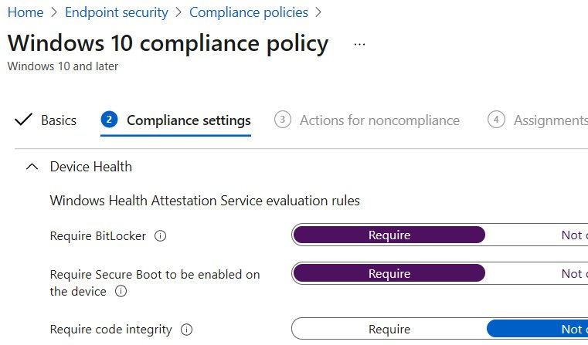
Windows
DHA with minimal or no impact on operation costs.
The DHA service integrates with MDM solutions and does the following:
Combines the info DHA service that's received from devices (through existing MDM device management communication channels) with the DHA report.
Makes more secure and trusted security decisions, based on attested hardware and protected data.
When leveraging DHA in a compliance policy, Windows 10 must be rebooted before it gets into a compliant state in Microsoft Intune.
Notes:
Windows
The Device Health Attestation (DHA) service validates the Trusted Platform Module (TPM) and Platform Configuration Register (PCR) logs for a device and then issues a DHA report. Microsoft offers the DHA cloud service, a Microsoft-managed DHA service that is free, geo-load-balanced, and optimized for access from different regions of the world.
DHA enables enterprises to raise the security bar of their organization to hardware monitored and attested security, with minimal or no impact on operation costs.
The DHA service integrates with MDM solutions and does the following:
Combines the info DHA service that's received from devices (through existing MDM device management communication channels) with the DHA report.
Makes more secure and trusted security decisions, based on attested hardware and protected data.
When leveraging DHA in a compliance policy, Windows 10 must be rebooted before it gets into a compliant state in Microsoft Intune.
In the Device Health section of the Windows compliance policy, there are three settings:

Slide 42
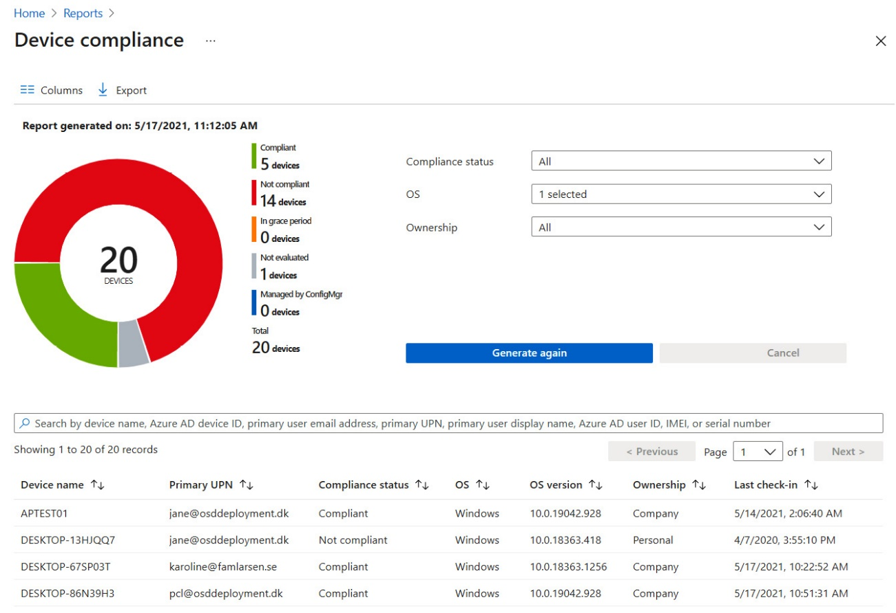
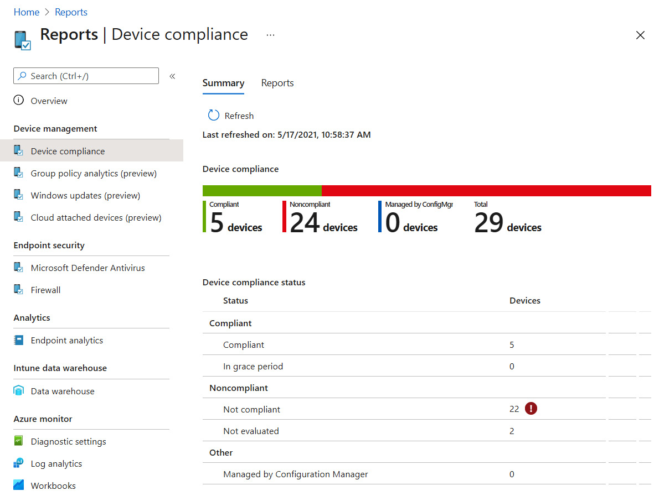
Organizational compliance report

Slide 43
Office Policy Management
Module 11
Notes:
You'll learn about the Office cloud policies in this chapter, and how you can use this cloud service to configure the Microsoft 365 apps that your end users have installed either on their Windows devices at home or their company-issued Windows devices that are managed by a management tool such as Microsoft Intune. This is not a replacement for GPO, administrative templates, or settings catalog policies in Microsoft Intune, but in some scenarios, you can leverage the Office cloud policy service.
We will also show how the Office Cloud policy service has Security Policy Advisor, which can help you and your enterprise to get insights into whether you have the correct security policy recommendations implemented. These recommendations are based on Microsoft best practices and information about your existing environment.

Slide 44
Chapter Overview
In this chapter, we will cover the following topics:
The Office cloud policy service
Creating a policy configuration with the OCP service
Security Policy Advisor

